Slide 1
Chapter-2 Graphics Hardware
Dhiraj Shrestha

Slide 2
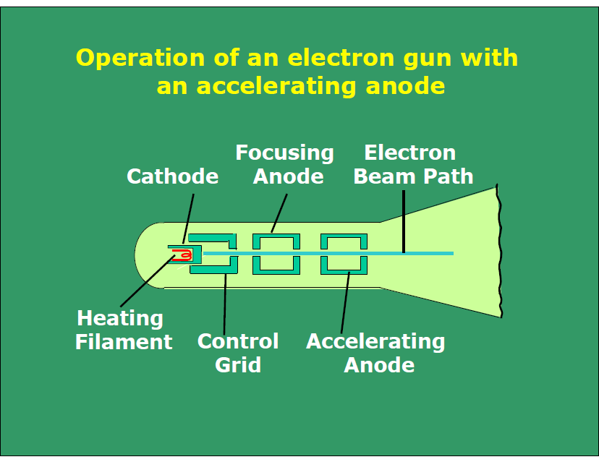

Slide 3
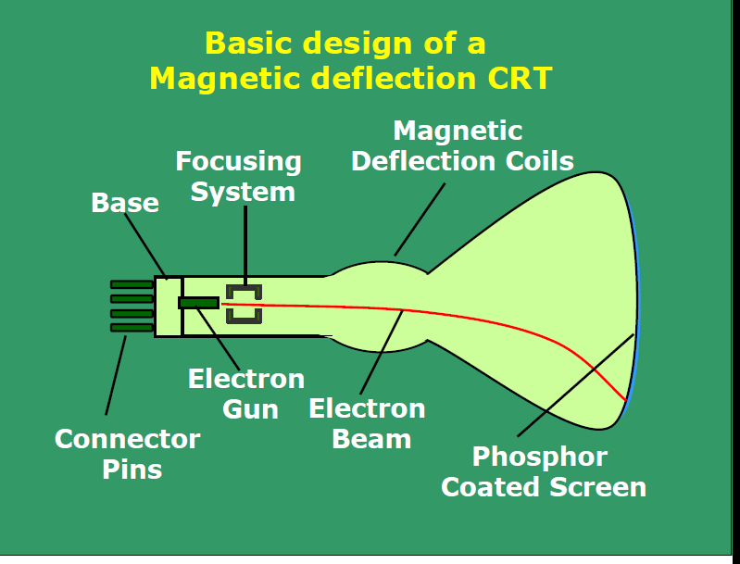

Slide 4
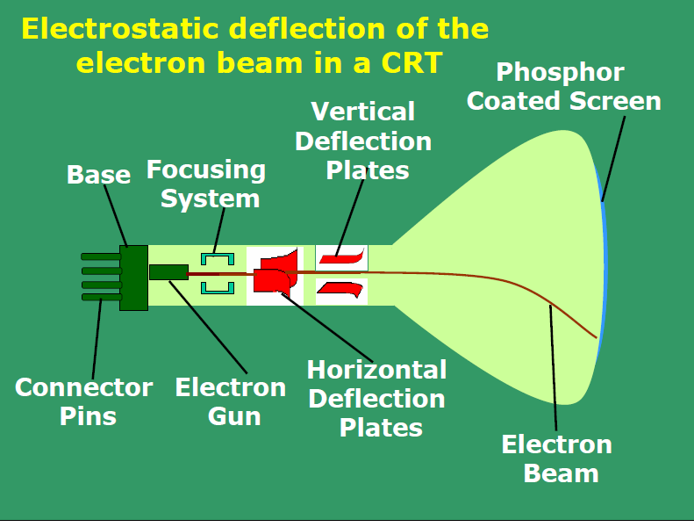

Slide 5
Terminology
Persistence
Resolution
Aspect ratio
Refresh rate
Bandwidth

Slide 6
Raster Scan Displays
Picture definitions are stored in refresh buffer or frame buffer which holds the setup intensity values for all the screen point also known as pixel. (pel)
Stored intensity values are retrieved form the refresh buffer and painted on the screen on scan line (one row at a time).
It is suited for realistic scenes containing shading and color pattern.
In monochrome monitor frame buffer consists of one bit per each pixel and for color monitor frame buffer consists of 24 bits for each pixel.
The refresh rate for this system is at the rate of 60 to 80 frame per second. i.e refresh rate are described in units of cycle per second.

Slide 7
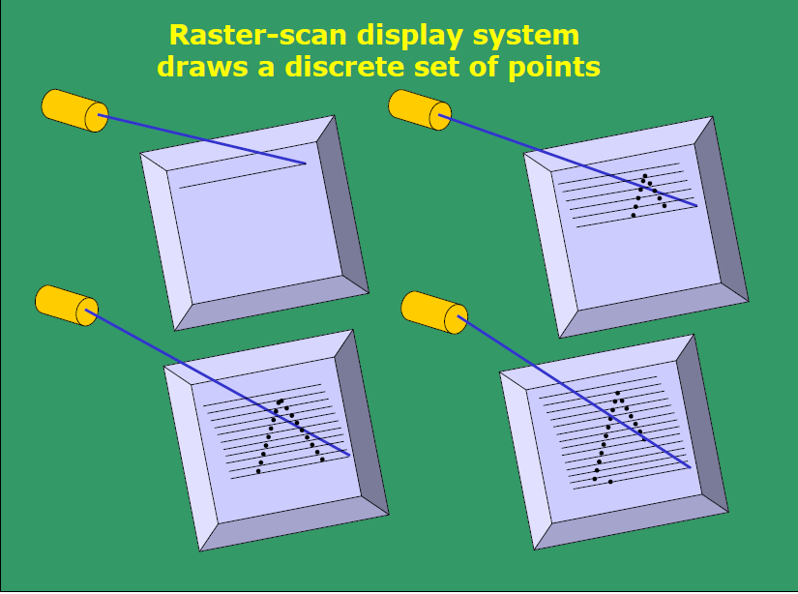

Slide 8
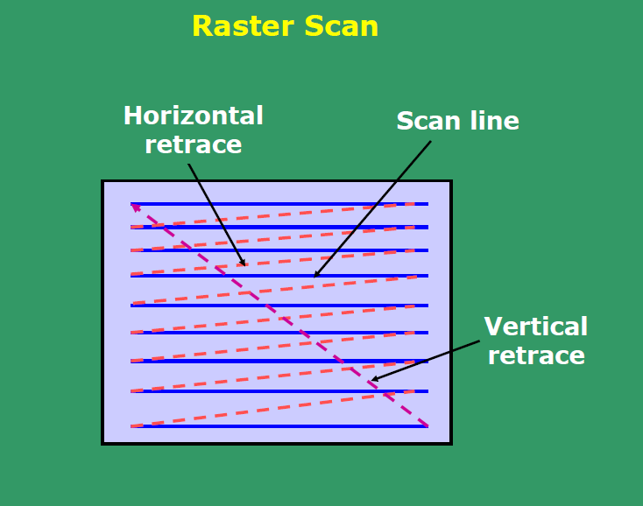
Raster Scan Displays
Bitmap / Pixmap
Retrace
Horizontal retrace
Vertical retrace

Slide 9
Raster Scan Displays
Raster Scan systems
Interlaced refresh procedures
Non interlaced refresh procedures

Slide 10
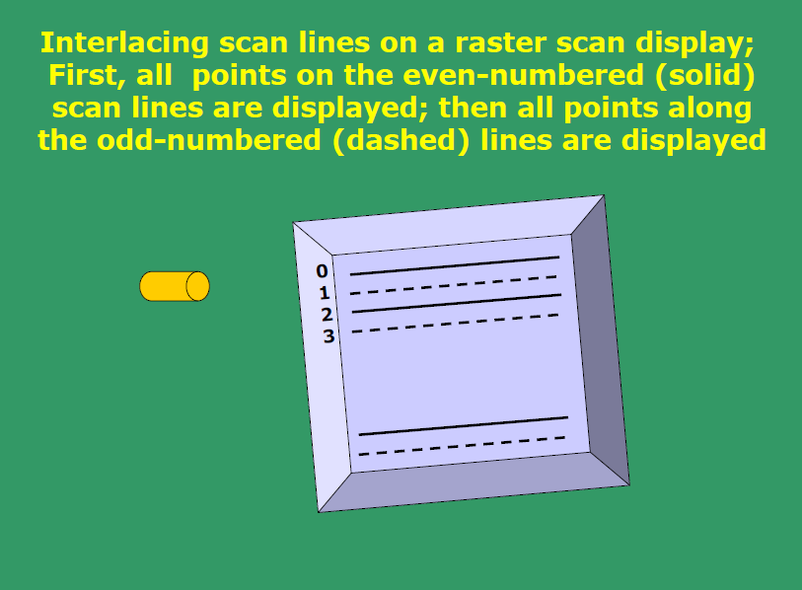

Slide 11
Random Scan Displays
In a random scan display, an image on the screen is drawn with one line at time and for this reason it is also called vector display.
An application program is input and stored in the system memory along with the graphic package.
Graphics commands in the application program are translated by the graphic package in to a display file stored in the system memory.
This display file is then accessed by the display processor to refresh the screen.
Sometimes the display processor in a random scan is referred to as a display processing unit or a graphics controller.

Slide 12
Random Scan Displays
The buffer stores the computer produce display list ordisplay program which contains points and line plotting commands with ( x, y) and end point co-ordinates as well as character plotting commands.
Vector display system are mostly used for line drawing applications and can not display realistic shaded scenes.
It produces smooth line drawing because the CRT beam directly follows the line path definitions that are stored in the form of line drawing commands.

Slide 13
Random Scan Displays
Drawbacks:
When the number of command in the buffer goes high the system take long time to process and draw pictures.
Cannot apply shading features.

Slide 14
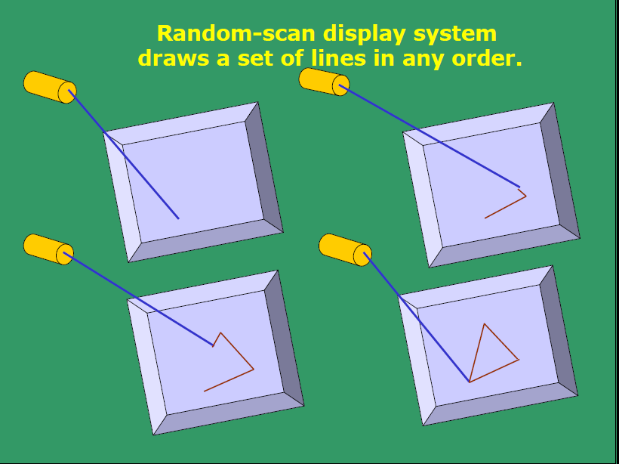

Slide 15
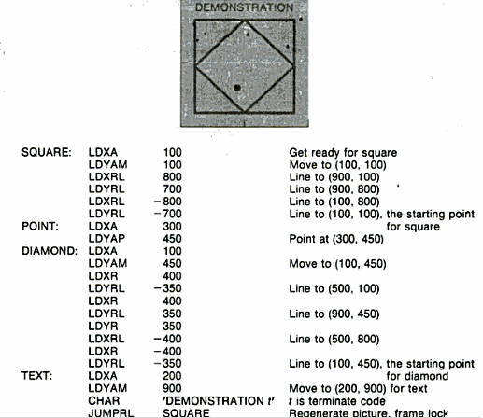
Program for random scan display processor

Slide 16
Color crt monitors
Basic techniques for producing displays with a CRT are :
Beam-penetration method
Shadow –mask method

Slide 17
Beam penetration Method
Two phosphorus layer (Red and green) are adjusted such that outer layer should red and inner layer should be green.
The color picture depends on how far the electron beam penetrates.
The slow electron beam only excite outer red layer
The high speed electron beam excite inner green layer
At the intermediate speed, the combination of red and green lights are emitted to show two additional colors orange or yellow

Slide 18
Shadow mask method
Delta- delta shadow-mask method
Inline arrangement method

Slide 19
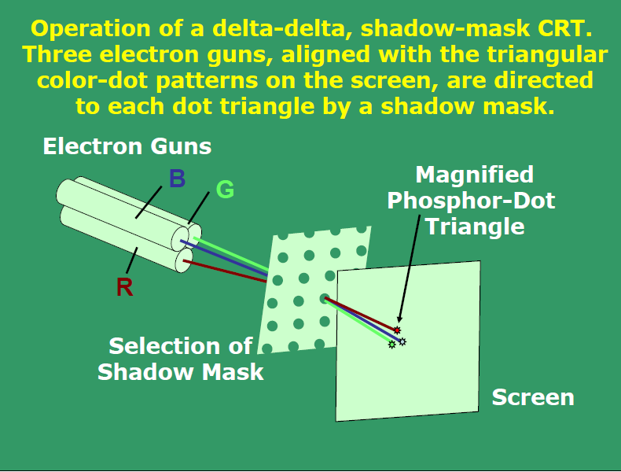
Delta – delta method

Slide 20
Delta – delta method
Operation of delta-delta mask CRT. These electron guns aligned with the triangular color dot patterns on the screen, are directed to each do triangle by a shadow mask.
Three types of phosphorus dots is coated in each pixel that is red, green and blue
Just behind the CRT screen shadow mask grid is placed whose number is same as a number of pixel.
Three electron gun is adjusted for each phosphorous
The electron beams is detected and focus on the shadow mask hole.
The Passed from the hole activate the dot triangle and produce the color spot on the screen.
The color of pixel is controlled by light of intensity. By combing three color, 17 million color can be obtained. For true color each pixel has 24 bits in the frame buffer.

Slide 21
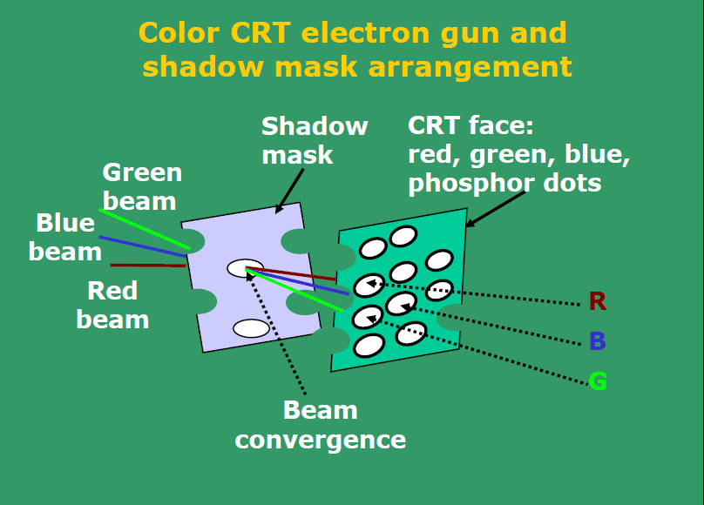
Delta – delta method

Slide 22
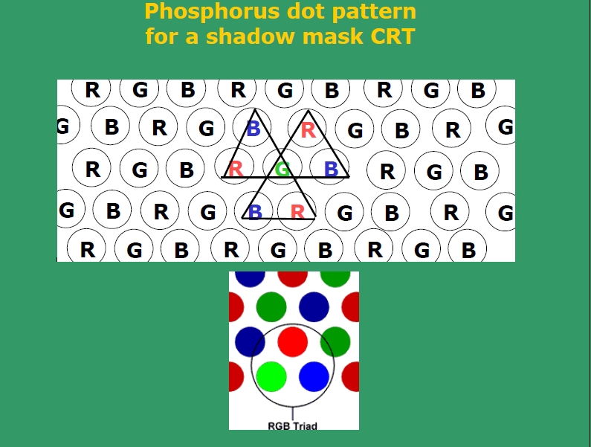

Slide 23
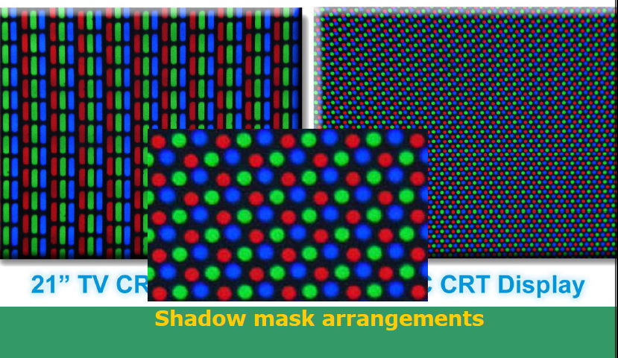

Slide 24
In-line arrangement
Three electron guns, and the corresponding red-green-blue color dots on the screen are aligned along one scan line
This inline arrangement of electron gun is easier to keep in alignment and is commonly used in high resolution color CRTs.

Slide 25
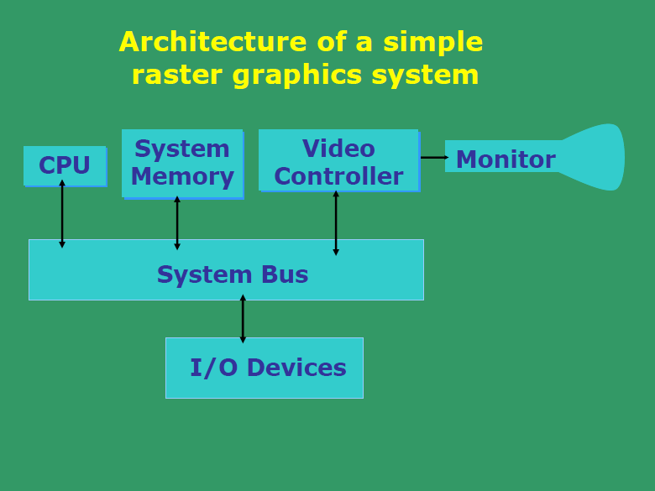
Architecture of raster scan systems

Slide 26
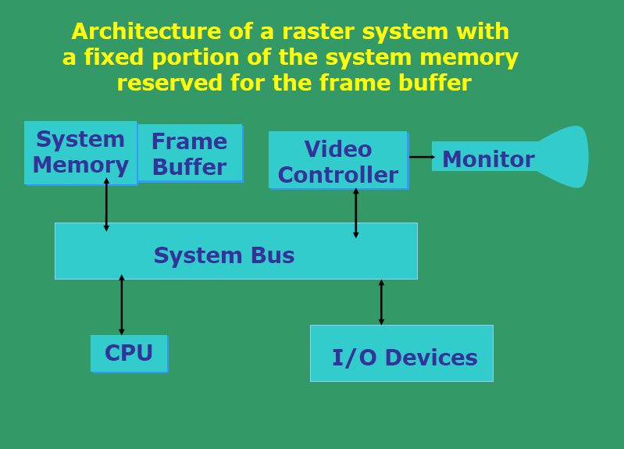

Slide 27
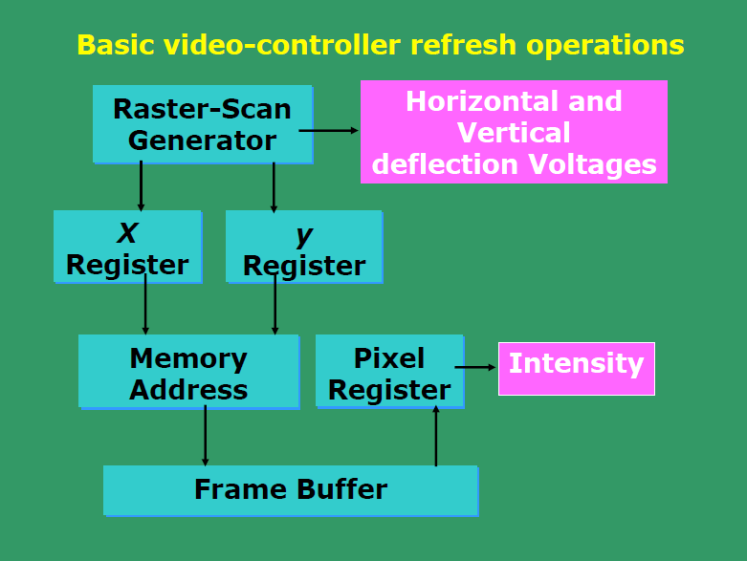

Slide 28
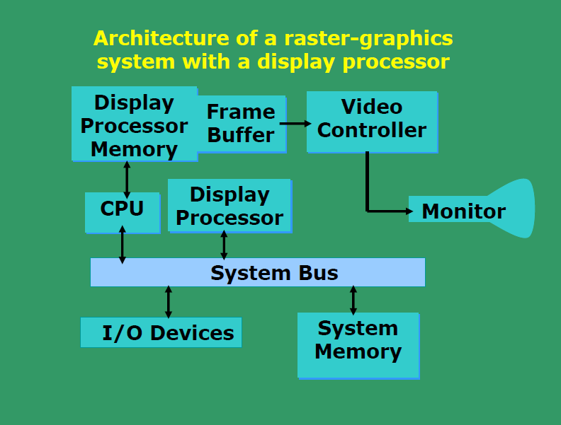

Slide 29
Operation of video controller
Basic refresh operations
It can retrieve pixel intensities from different memory areas on different refresh cycles
Some transformations like scaling, translation, rotation
It contains lookup table , so that the pixel values in the FB are access from LUT
It mix the frame buffer image with an i /p image from television camera or other i /p device.

Slide 30
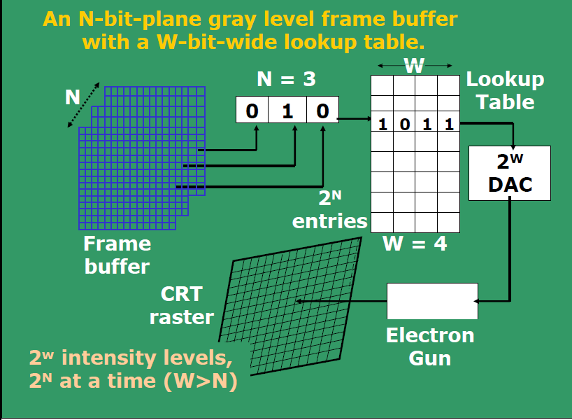

Slide 31
Raster-scan display processor
Main purpose is to free CPU from the graphics chores
Digitizing a picture definition given in an application program into a set of pixel-intensity values for storage in the FB.
Generating various line styles, displaying color areas, certain transformation and manipulation on displayed objects.

Slide 32
Run length encoding
It reduces the memory requirements for storing the picture information in frame buffer
This method uses the concept of linked list for storing the intensity information in FB
One number of each pair indicates an intensity value , and the second number specifies the number of adjacent pixels on the scan line that are to have that intensity value.

Slide 33
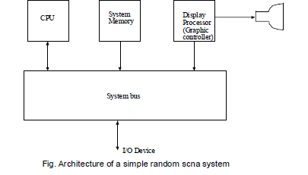
Architecture of Random-scan display

Slide 34
End of graphics hardware

